Slide 1
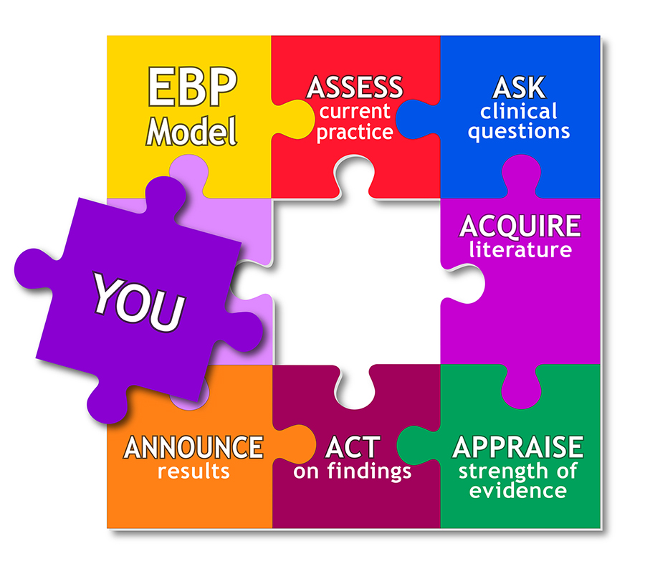
Evidence Based Approaches
WEEK 4- SLIDE
Evidence based Approaches

Slide 2
Module lecturer-Tayo Alebiosu
Health and Social Care
Evidence Based Approaches
Contact me: tayo.alebiosu@lsclondon.co.uk

Slide 3

Aim;
Explain critical research skills and applying logic in critical thinking within evidence-based approaches.
Learning outcomes At the end of this lesson students will be able to ;
Explore critical thinking skills to evaluation of information
Apply critical thinking skills to problem-solving scenarios

Slide 4
Defining Critical Thinking
Critical thinking is clear, reasonable, reflective thinking focused on deciding what to believe or do. It means asking probing questions like, “How do we know?” or “Is this true in every case or just in this instance?” It involves being skeptical and challenging assumptions, rather than simply memorizing facts or blindly accepting what you hear or read.
Thinking comes naturally. You don’t have to make it happen—it just does. But you can make it happen in different ways. For example, you can think positively or negatively. You can think with “heart” and you can think with rational judgment. You can also think strategically and analytically, and mathematically and scientifically. These are a few of multiple ways in which the mind can process thought.

Slide 5
“THINKING CRITICALLY AND CREATIVELY”
Critical thinking skills are perhaps the most fundamental skills involved in making judgments and solving problems. You use them every day, and you can continue improving them.
The ability to think critically about a matter—to analyze a question, situation, or problem down to its most basic parts—is what helps us evaluate the accuracy and truthfulness of statements, claims, and information we read and hear. It is the sharp knife that, when honed, separates fact from fiction, honesty from lies, and the accurate from the misleading.
We all use this skill to one degree or another almost every day.

Slide 6
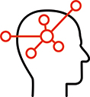
Critical thinking is a mental process of questioning and evaluating what you read, hear, and see (Palgrave, n.d.). Being able to question or doubt ideas or arguments and not accept them at face value is part of the process. You will need to demonstrate the ability to think critically by:
analysing – breaking information down and drawing together your own judgements of the evidence, then synthesising or recombining it in different ways and explaining how parts fit into a whole
interpreting – the ability to understand information, look at trends and patterns, identify repetition, and note the finer details which may help you clarify its meaning
reasoning – using a logical process to build an argument
evaluating – judging the strength of an argument and ensuring that it is well supported

Slide 7
This process involves:
critical reading – questioning the information and arguments in the text
critical reflection – deepening your learning by focusing on your experiences to help you clarify your thinking
reasoning – developing a line of reasoning to reach a conclusion
critical writing – supporting your argument, be clear, well-structured and well-referenced
You can use the learning cycle and the six questions (5W + 1H system) to trigger your critical thinking.
Think about the six questions: What, Who, When, Where, Why, and How, as demonstrated in the table below.

Slide 9

LO 1 Activity
Individually, using your internet device, research your
Understanding of critical thinking skills within evidence-based approaches
OR
How do you apply critical thinking skills in our everyday practice in healthcare sector
Feedback to the class

Slide 10
Features of effective critical thinking in health care
Effective critical thinking in health care involves what four features?
Identify the problem.
Gather information and identify possible solutions.
Select the best option.
Implement the solution.
Evaluate the results

Slide 11
There is a problem/ issue / gap/experience- (Example-Physical abuse in a care home)
As a healthcare practitioner , you reflected on the issue (-Physical abuse in a care home)
Now, you want to carry out an EBP to solve the problem----Remember, EBP involves three major elements : (a)Your experience/ expertise- (b)Already existing literature about the issue and (c) patience / service users preference.
You then apply the below 3,4,5,6 to carry out the above a, b and c (EBP):
3. Critical thinking skills
4. Apply logic
5. Problem solving skills
6. Solution
Note: I only use –(Physical abuse in a care home) as an example, you can choose any topic of your choice.

Slide 12

How is critical thinking used in healthcare?
Critical thinking is applied by healthcare practitioners in the process of solving problems of patients and decision-making process with creativity to enhance the effect. It is an essential process for a safe, efficient and skilful healthcare intervention.
Critical thinking refers to a person's ability to think rationally and analyze and interpret information and make connections. This skill is important in research because it allows individuals to better gather and evaluate data and establish significance.

Slide 13
The Importance of Critical Thinking in Evidence-Based Practice
One of the most important components of EBP is critical thinking, which is defined as a thinking skill consisting of the evaluation of arguments.
It is a “purposeful, self-regulatory judgment” that interprets analysis, evidence, and methodology when seeking a decision.
Used as a component of EBP, critical thinking means the provider should consistently evaluate how much to trust the findings of a given research study.
The provider must also make sure the selection of evidence is focused on what is best for the patient, rather than stem from the provider’s personal belief system.

Slide 14

Improve patient outcomes with critical thinking skills
It’s easy to see why employers highly value critical thinking in healthcare. Healthcare delivery systems can no longer afford to be mistaken about best thinking.
Error rates are already in question, difficult problems and decisions must be addressed, and poor judgments can lead to irreparable damage and even cost lives.
Positive patient outcomes are improved when healthcare professionals bring strong critical thinking skills to their work.

Slide 15

Critical thinking is something you’ll do every day as a healthcare practitioner and honestly you probably do it in your everyday life as well. It’s basically stopping, looking at a situation, identifying a solution and trying it out. Critical thinking in nursing is just that, but in a clinical setting.
Critical thinking in nursing is a valuable skill that can greatly improve the care you provide to your patients. If you take the time to follow these five tips to improve your critical thinking skills, your reward will be better outcomes for your patients and more confidence in your abilities as a nurse.
Critical thinking as a valuable skill

Slide 16
“THINKING CRITICALLY AND CREATIVELY”
The academic setting demands more of us in terms of critical thinking than everyday life.
It demands that we evaluate information and analyze issues.
It is the environment where our critical thinking skills can be the difference between success and failure.
In this environment we must consider information in an analytical, critical manner.

Slide 17
Features of a good Critical thinker
1. Be aware of personal bias and assumptions- Human beings tend to allow personal bias to affect their decisions, and critical thinking in healthcare is no exception. Do hidden values or beliefs drive your behavior?“
2. Learn from all available resources- Critical thinking in healthcare requires a familiarity with a range of medical conditions and procedures. Actively brushing up on your knowledge will help you identify connections in your patients' care and know how to address any issues.
3. Reflect on each day- At the end of each shift, take some time to reflect on the day's events. There will always be situations you could have approached differently or better solutions to the problems you faced, so it's important to go through those things to see where you can improve.

Slide 18
Critical thinking Skills- contd
4. Practice critical thinking daily-Critical thinking in healthcare is a skill that can be learned and improved, so make sure you're enhancing your skills daily using the tools available to you.
5. Maintain flexibility- Finally, a good critical thinker will maintain flexibility.

Slide 19
Key Critical Thinking Skills
Some skills are more important than others when it comes to critical thinking. Some of these skills are applied in patient care. The skills that are most important are:
Interpreting – Understanding and explaining the meaning of information, or a particular event.
Analyzing – Investigating a course of action, that is based upon data that is objective and subjective.
Evaluating – This is how you assess the value of the information that you got. Is the information relevant, reliable and credible?
Based upon those three skills, the healthcare practitioner can then use clinical reasoning to determine what the problem is. These decisions have to be based upon sound reasoning:
Explaining – Clearly and concisely explaining your conclusions. The healthcare practitioner needs to be able to give a sound rationale for her answers.
Self regulating – You have to monitor your own thinking processes. This means that you must reflect on the process that lead to the conclusion. You should self correct in this process as needed. Be on alert for bias and improper assumptions.

Slide 20
Class Activity (10 minutes)
Why think critically in healthcare practice
Feedback to the class

Slide 21
Why critical thinking in healthcare is important
To be an effective healthcare practitioner, it's important to step back and see the bigger picture. Critical thinking in healthcare helps you analyze your patient's condition and current treatments to predict outcomes and identify potential issues.
Healthcare practitioner who think critically do a better job of communicating across disciplines to ensure that all providers are aware of the patient's status, needs, and responses to treatment.
Being a strong critical thinker can greatly impact the experiences of your patients.
An example: "a critically thinking healthcare practitioner will hold a patient's blood pressure medicines and contact the physician when he or she notes that the patient's blood pressure is below an acceptable level.“
In this case, lack of critical thinking skills could put the patient in jeopardy by allowing the blood pressure to continue falling.

Slide 22
Assessing critical thinking in healthcare professionals
Many healthcare centres assess critical thinking to improve clinical judgment skills and minimize errors.
Objective critical thinking data becomes an essential component in their hiring and staff development programs.
Hospitals, medical centers and medical schools depend upon the Insight Assessment test instruments specifically calibrated to measure critical thinking in healthcare students and professionals.

Slide 23
https://youtu.be/WiSklIGUblo
A look at some of the principles of critical thinking.

Slide 24
LO2 Activity
Individually, with extracts from the below video clip,
Explore the meaning of critical thinking
Identify how to apply critical thinking skills to evaluation of information
-Feedback to the class
https://youtu.be/HnJ1bqXUnIM
Critical Thinking encompasses six vital skills: problem solving, analysis, creative thinking, interpretation, evaluation, and reasoning.
https://youtu.be/WiSklIGUblo
A look at some of the principles of critical thinking.

Slide 25
Examples of the application of critical thinking in healthcare
To accurately diagnose emergent conditions;
To determine and evaluate therapeutic actions;
To analyze and manage health risks;
To hire and promote healthcare leaders;
To design innovative clinical systems;
To achieve goals of agency initiatives;
To allocate resources;
To anticipate and prevent errors;
To use and manage information systems;
To understand treatment implications;
To develop data driving protocols;
To anticipate the implications of actions taken;
To analyze and resolve personnel issues;
To explain policy & protocols; and
To design and evaluate departmental reports.

Slide 26
Why think critically
Why is this going to benefit you?
Attention and observation
More focused reading
Improved ability to identify key points
Improved ability to respond to key points
Knowledge of how to get you own point across
Skills in analysis.
Questioning own point of view; checking evidence used to support it.
Challenging and takes courage – we don’t like to think we don’t know ourselves well; we don’t like to put ourselves out on a limb, offering up opinions that might go against the grain.

Slide 27
How to develop your thinking skills
Critical thinking skills are based on underlying sets of thinking skills.
Focusing attention – recognise significance of fine details
Using attention to fine detail in recognising patterns – similarity & difference, absence & presence, order & sequence.

Slide 28
Things to think about
Scepticism and trust
Polite doubt
What you know at a given time may only be part of the picture
Paying attention to detail /repetition in reading and checking nothing has been missed
Taking different perspectives
Objectivity – putting your own likes/beliefs and interests to one side with the aim of gaining the most accurate information/deeper understanding

Slide 29
Contd..
Who are critical thinkers, and what characteristics do they have in common?
Critical thinkers are usually curious and reflective people.
They like to explore and probe new areas and seek knowledge, clarification, and new solutions.
They ask pertinent questions, evaluate statements and arguments, and they distinguish between facts and opinion.
They are also willing to examine their own beliefs, possessing a manner of humility that allows them to admit lack of knowledge or understanding when needed. They are open to changing their mind. Perhaps most of all, they actively enjoy learning, and seeking new knowledge is a lifelong pursuit.
This may well be you!

Slide 30
Critical thinking as a student means:
Finding the best evidence
Evaluating (making a judgement) the evidence and supporting arguments
Coming to an opinion about where it is leading
Describing how you came to your opinion from the evidence you had collected
Illustrate your argument

Slide 31
Contd..
We must ask questions—
What is the source of this information?
Is this source an expert one and what makes it so?
Are there multiple perspectives to consider on an issue?
Do multiple sources agree or disagree on an issue?
Does quality research substantiate information or opinion?
Do I have any personal biases that may affect my consideration of this information?
It is only through purposeful, frequent, intentional questioning such as this that we can sharpen our critical thinking skills and improve as students, learners and researchers.

Slide 32
Now… let look at Problem solving using logic
Problem solving is all about using logic, as well as imagination, to make sense of a situation and come up with an intelligent solution. In fact, the best problem solvers actively anticipate potential future problems and act to prevent them or to mitigate their effects.
A good problem-solving process involves four fundamental stages:
Problem definition,
Devising alternatives,
Evaluating alternatives and then
Implementing the most viable solutions.

Slide 33
Research confirms that patient outcomes improve healthcare practitioners' practice in an evidence-based manner. Described as “a problem-solving approach to clinical care that incorporates the conscientious use of current best practice from well-designed studies, a clinician’s expertise, and patient values and preferences,”.
Evidence-based practice (EBP) has been shown to increase patient safety, improve clinical outcomes, reduce healthcare costs, and decrease variation in patient outcomes.
The importance of EBP is substantiated; however, barriers to widespread use of current research evidence in healthcare practitioners’ remain, including the fluency and knowledge level of clinical nurses.

Slide 34
Problem-Solving With Critical Thinking
For most people, a typical day is filled with critical thinking and problem-solving challenges. In fact, critical thinking and problem-solving go hand-in-hand.
They both refer to using knowledge, facts, and data to solve problems effectively. But with problem-solving, you are specifically identifying, selecting, and defending your solution.
Below are some examples of using critical thinking to problem-solve:
Your roommate was upset and said some unkind words to you, which put a crimp in your relationship. You try to see through the angry behaviors to determine how you might best support your roommate and help bring your relationship back to a comfortable spot.

Slide 35
Examples of using critical thinking to solve problem
You have a job interview for a position that you feel you are only partially qualified for, although you really want the job and you are excited about the prospects. You analyze how you will explain your skills and experiences in a way to show that you are a good match for the prospective employer.
You are doing well in college, and most of your college and living expenses are covered. But there are some gaps between what you want and what you feel you can afford. You analyze your income, savings, and budget to better calculate what you will need to stay in college and maintain your desired level of spending.

Slide 36
Examples of using critical thinking to solve problem
Your campus club has been languishing on account of lack of participation and funds. The new club president, though, is a marketing major and has identified some strategies to interest students in joining and supporting the club. Implementation is forthcoming.
Your final art class project challenges you to conceptualize form in new ways. On the last day of class when students present their projects, you describe the techniques you used to fulfill the assignment. You explain why and how you selected that approach.
Your math teacher sees that the class is not quite grasping a concept. She uses clever questioning to dispel anxiety and guide you to new understanding of the concept.

Slide 37
ASSESSMENT SUBMISSION
All assignment will be submitted in electronic format and uploaded to LSC Portal on Turnitin
Date assignment set: March 2021
Submission deadline date: 1st June 2021
Return date to students: 28/06/2021
Word Limit: 2500 words
Assessment Weighting Criteria (100%)

Slide 38
Today, we have explored …..
Explore critical thinking skills to evaluation of information
Apply critical thinking skills to problem-solving scenarios

Slide 39
Critical thinking encompasses six vital skills
https://youtu.be/HnJ1bqXUnIM
Critical Thinking encompasses six vital skills: problem solving, analysis, creative thinking, interpretation, evaluation, and reasoning.
https://youtu.be/WiSklIGUblo

Slide 40
Reference
NIHR. (2018). Why Research Matters. Available: https://www.nihr.ac.uk/patients-and-public/why-join-in/why-research-matters.htm. ,Last accessed 07 Feb 2020.
Skills You Need (2020) Available at: https://www.skillsyouneed.com/learn/literature-review.html [Accessed: 07/02/2020]
https://courses.lumenlearning.com/suny-basicreadingwriting/chapter/outcome-critical-thinking/
Resnick, D. B. (2015) What is Ethics in Research and Why is it Important? Available at: https://www.skillsyouneed.com/learn/research-ethics.html [Accessed: 08/02/2020]
https://www.projectguru.in/publications/importance-ethical-considerations-research/
https://nursing.com/blog/2-examples-used-critical-thinking-care-patient-real-life-nursing-stories/
Gomm, R. (2000) ‘Would it work here’ in Gomm, R. and Davies, C. (eds) (2000) Using Evidence in Health and Social Care, London, Sage Publications/Open University.
https://targetjobs.co.uk/careers-advice/skills-and-competencies/300766-problem-solving-the-mark-of-an-independent-employee

Slide 41
References
Barnett (1997) in Brechin, A. (2000) ‘Introducing critical practice’ in Brechin, A., Brown, H. and Eby, M. (eds) (2000) Critical Practice in Health and Social Care, London, Sage Publications/Open University.
Brookes, N. and Barrett, A. (2003) ‘Identifying nurse and health visitor priorities in a PCT using the Delphi technique’, British Journal of Community Nursing, Vol.8, No.8, pp. 376-380.
Closs, S.J. and Cheater, F.M. (1999) ‘Evidence for nursing practice: a clarification of the issues’, Journal of Advanced Nursing, Vol.30, No.1, pp. 10-17.
https://www.pearson.com/content/dam/one-dot-com/one-dot-com/us/en/higher-ed/en/products-services/course-products/berman-10e-info/pdf/CH10.pdf
https://www.glassdoor.com/blog/guide/research-skills/#Research_skills_examples
“Improving the Effectiveness of the Helping Professions: An Evidence-Based Approach to Practice.”
Needham, G. (2000) ‘Research and practice: making a difference’ in Gomm, R. and Davies, C. (eds) (2000) Using Evidence in Health and Social Care, London, Sage Publications/Open University.
https://www.bing.com/videos/search?q=evidence+based+practice+in+health&&view=detail&mid=B40B228DE6130896C17BB40B228DE6130896C17B&&FORM=VRDGAR

Slide 42
Critical thinking Skills
Open-mindedness
Inference
Analysis
Evaluation
Interpretation
Observation

